Slide 1
Chapter 1 Introduction to Information Retrieval
Dr. Dai Yu

Slide 2
What is Information Retrieval
Search on the Web is a daily activity for many people
Search and Communication are most popular uses of the computer

Slide 3
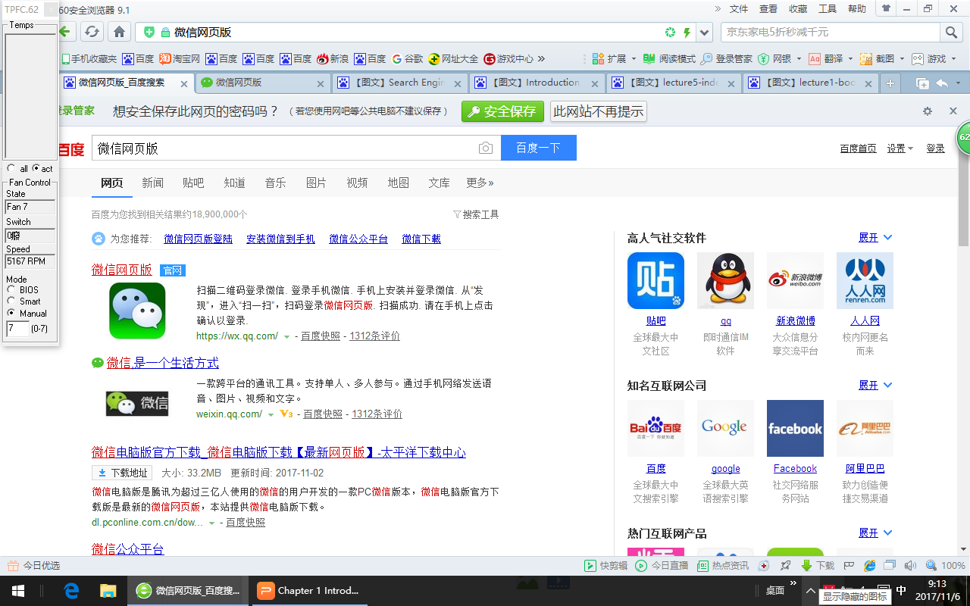
What is Information Retrieval?

Slide 4
What is Information Retrieval
A process for finding documents (text mostly) that help someone satisfy an information need
Includes related tasks
Classification-assign documents to know classes
Routing-direct documents to proper person
Filtering-select documents for a long standing requests
Clustering-unsupervised grouping of related documents

Slide 5
What is a Document?
Examples:
web pages, text, messages, PDF, word, email, ..
not just text, also inculdes video, image
Common properties
significant text content
some structure (e.g. title author, subject...)

Slide 6
Documents VS Database
Database records are typically made up of well defined field
bank records with account number, balances, name, address...
easy to compare fields with well defined semantics to queries in order to find match
Text is more difficult
find records with balance > 5000->easy to compare
find bank standards->difficult to compare the text in the whole stories

Slide 7
Documents VS Database
In Summary
databases
structured data
fields with reasonably clear semantics
strict query language
Information Retrieval
unstructured data
no semantics on “fields”
free text query, usually natural language

Slide 8
The core to Information Retrieval
comparing the query text to the document text and determining what is a good match is the core to the information retrieval.
Exact matching of word is not enough
many different ways to write the same thing in the Natural Language
some stories will be better matches

Slide 9
Big Issues in Information Retrieval
Relevance
A relevant document contains the information that a person was looking for when they submitted a query
many factors influence a person's decision about what is relevant: e.g. style, topic, context....
Retrival models define a view of relevance
Ranking algorithms are based on retrieval models
most models define statistical properties rather than linguistic
counting simple text features of words

Slide 10
Big Issues in Information Retrieval
Evaluation
Typically use test collection of documents, queries, and relevance judgements
Recall and Precision are two examples
Users and Information Needs
Search evaluation is user-centric
Keyword queries are ofter poor descriptions of actual information needs
interaction and context are importatnt for understanding user intent
Query refinement techniques such as query suggestion, relevance feedback improvement ranking

Slide 11
IR and Search Engines
A search engine is the pratical application of information retrieval techniqes to large scale text collections
web search engines are best known examples
Open source search engines are important for research and development
e.g. Lucene

Slide 12
Search Engine Issues
Performance
Measuring and Improving the efficiency of search
reducing response time, increasing query throughput, increasing indexing speed
Indexes are data structures designed to improve search efficiency
Dynamic Data
The collection for most real application is constantly changing in terms of update, deletion, insertion
Acquiring or crawling the documents is a major task
updating the indexes while process queries is a design issueBig Issues in Information Retrieval

Slide 13
Search Engine Issues
Scalability
making everything work with millions of users every data, and many terabytes of documents
Distributed processing is essential
Adaptability
Changing and tuning search engine components such as ranking algorithm, indexing strategy, interface for different applications

